Slide 1
REPORT WRITING
Written by : MEGHA B

Slide 2
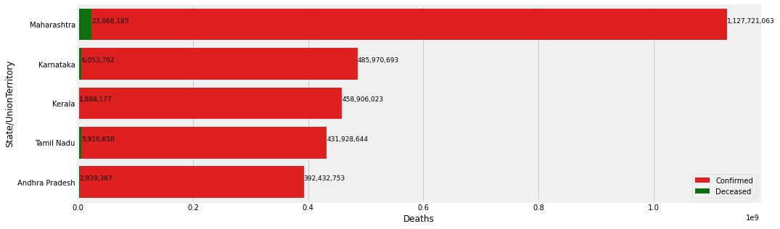
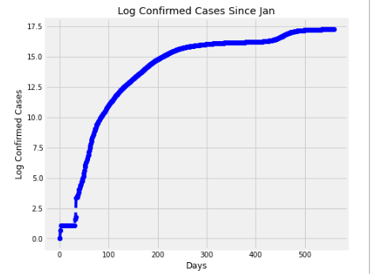
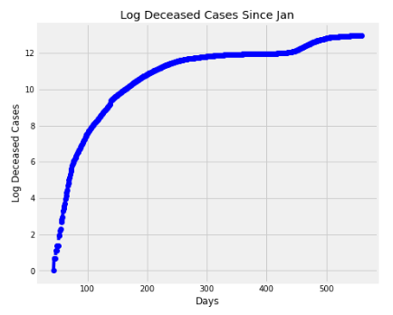
1. Write a python script to plot the Cumulative distribution of confirmed and deceased.
Check if it follows an exponential rise then justify the reason

Slide 3
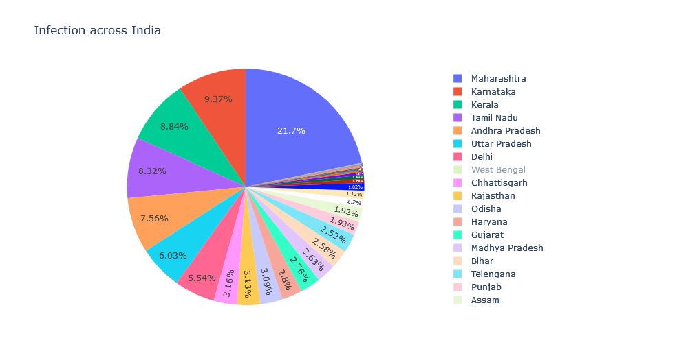
2. Write a python script to analyse the COVID-19 spread in different states of India

Slide 4
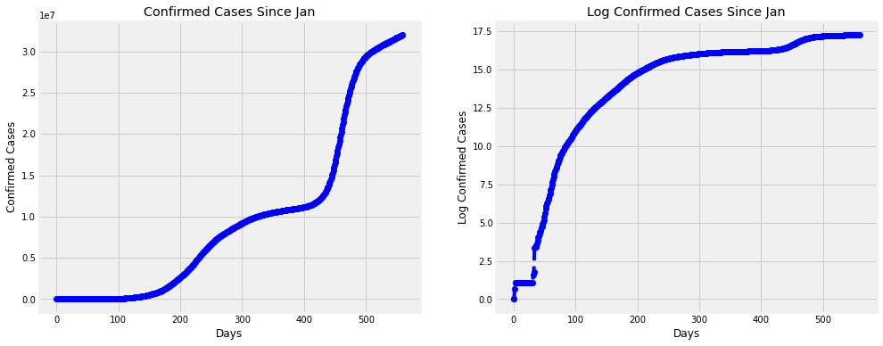
Develop an exponential model for COVID India confirmed cases

Slide 5
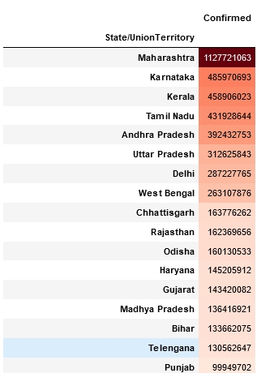
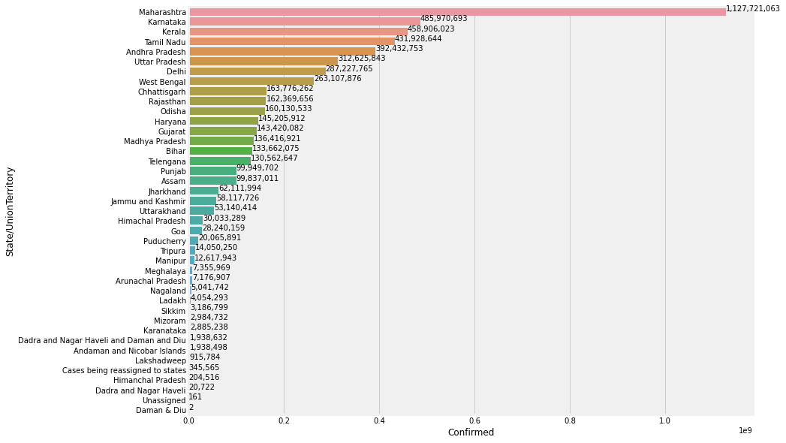
Analyze the outbreak of COVID-19 across various states in India and visualize them
through necessary charts. Derive your insight about the spread for the State of Kerala

Slide 6
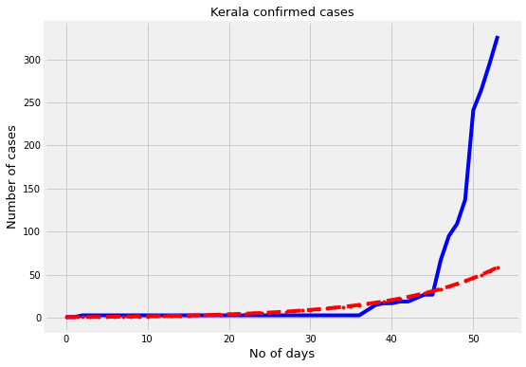
Model the Kerala COVID-19 outbreak using mathematical models to forecast the disease spread

Slide 7
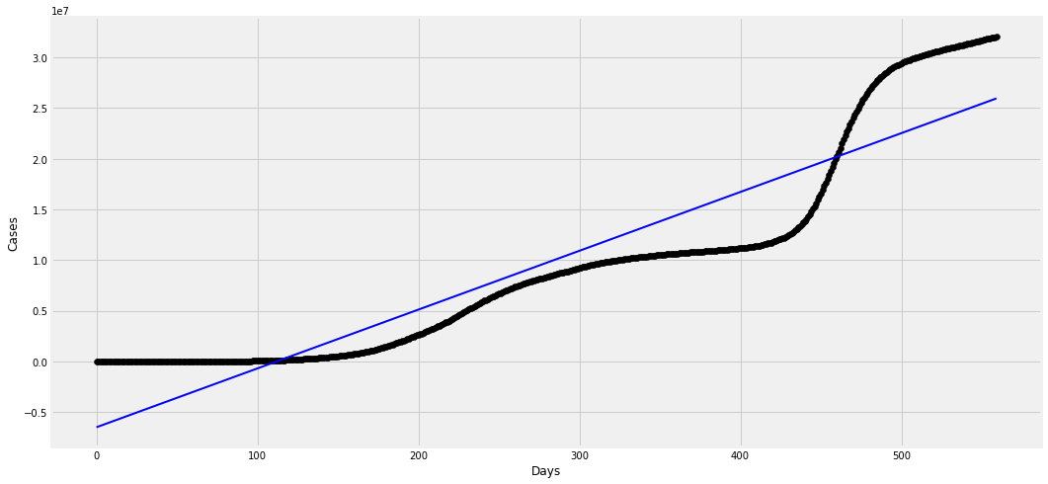
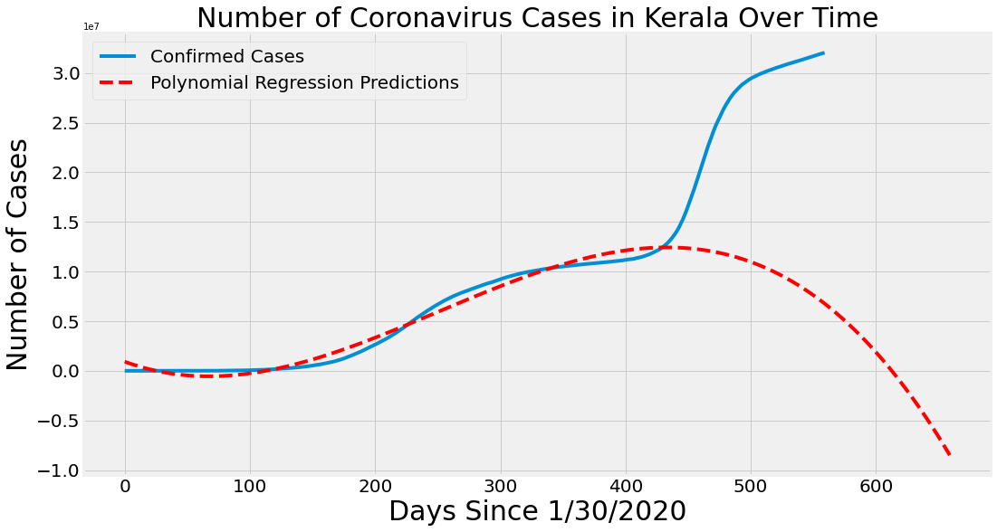
Develop a machine learning model for the State of Kerala to forecast the disease spread
LINEAR MODEL MACHINE MODEL

Slide 8
THANKYOU

